Slide 1



Resistor Value Recognizer
ADAFruit TSL2591 Luminosity Sensor

Slide 2
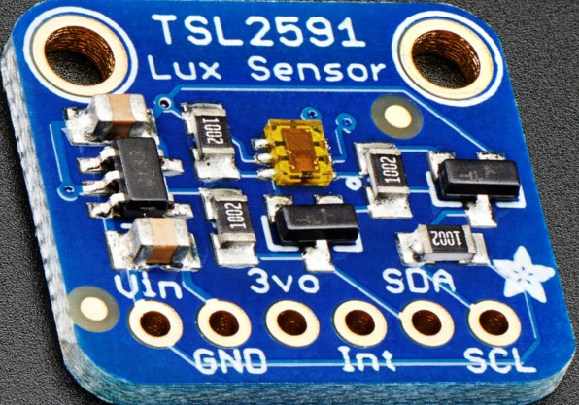
Proposal
Image processing is dependent on surrounding illumination.
This project dealt with designing and programming a luminosity sensor (TSL2591) to check the illumination of the surroundings.
This project will be used in next semester for LED control.

Slide 3


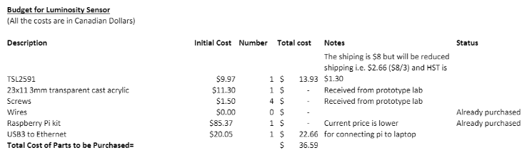
Budget
Items bought were:-
TSL2591 Sensor
USB3 to Ethernet

Slide 4
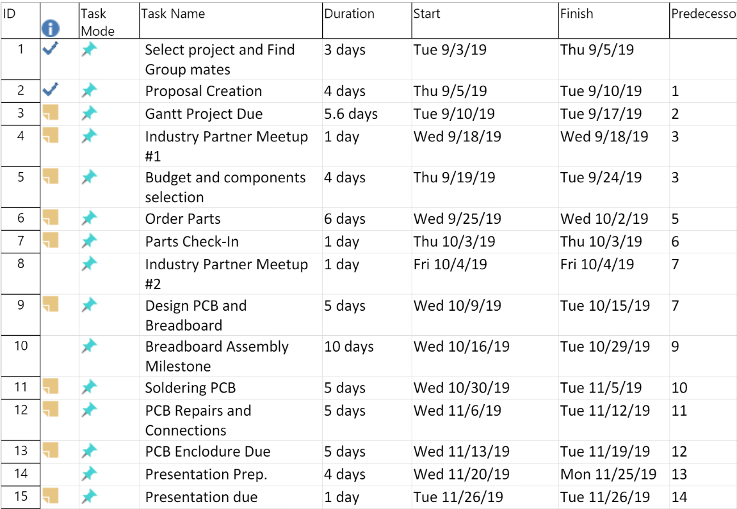
Schedule
Key Tasks:-
Proposal, Research, Budget, Schedule
Partner Meetings
Acquiring Parts
Breadboarding, PCB Design and Soldering
Software Researching, Sensor and PCB Power Up
Project Enclosure
Presentation

Slide 5
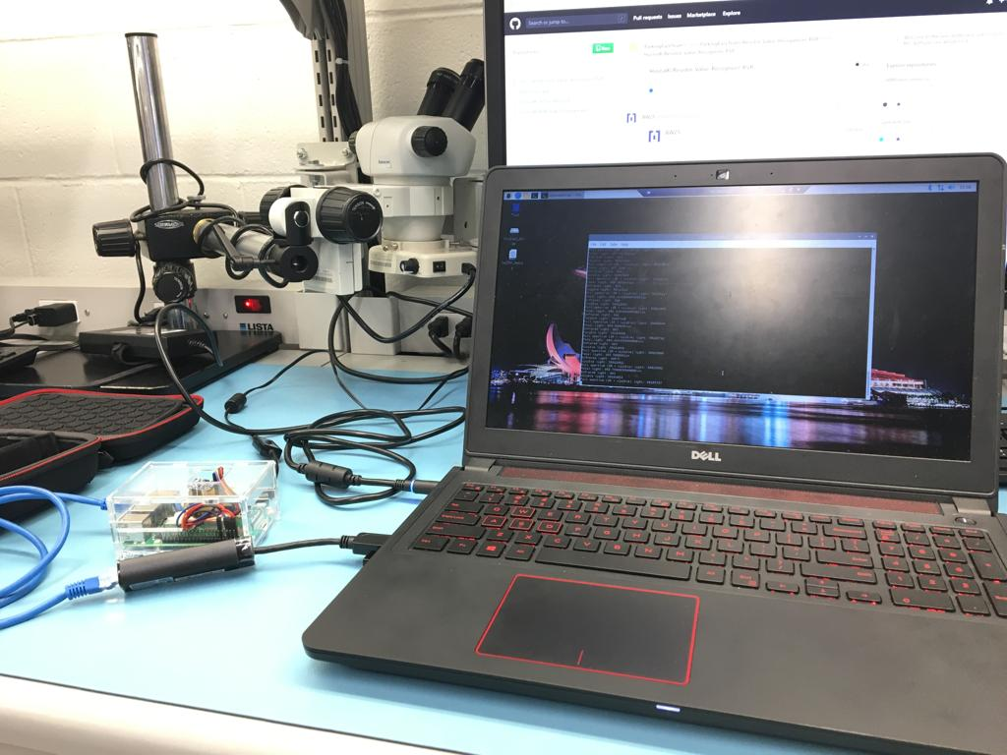
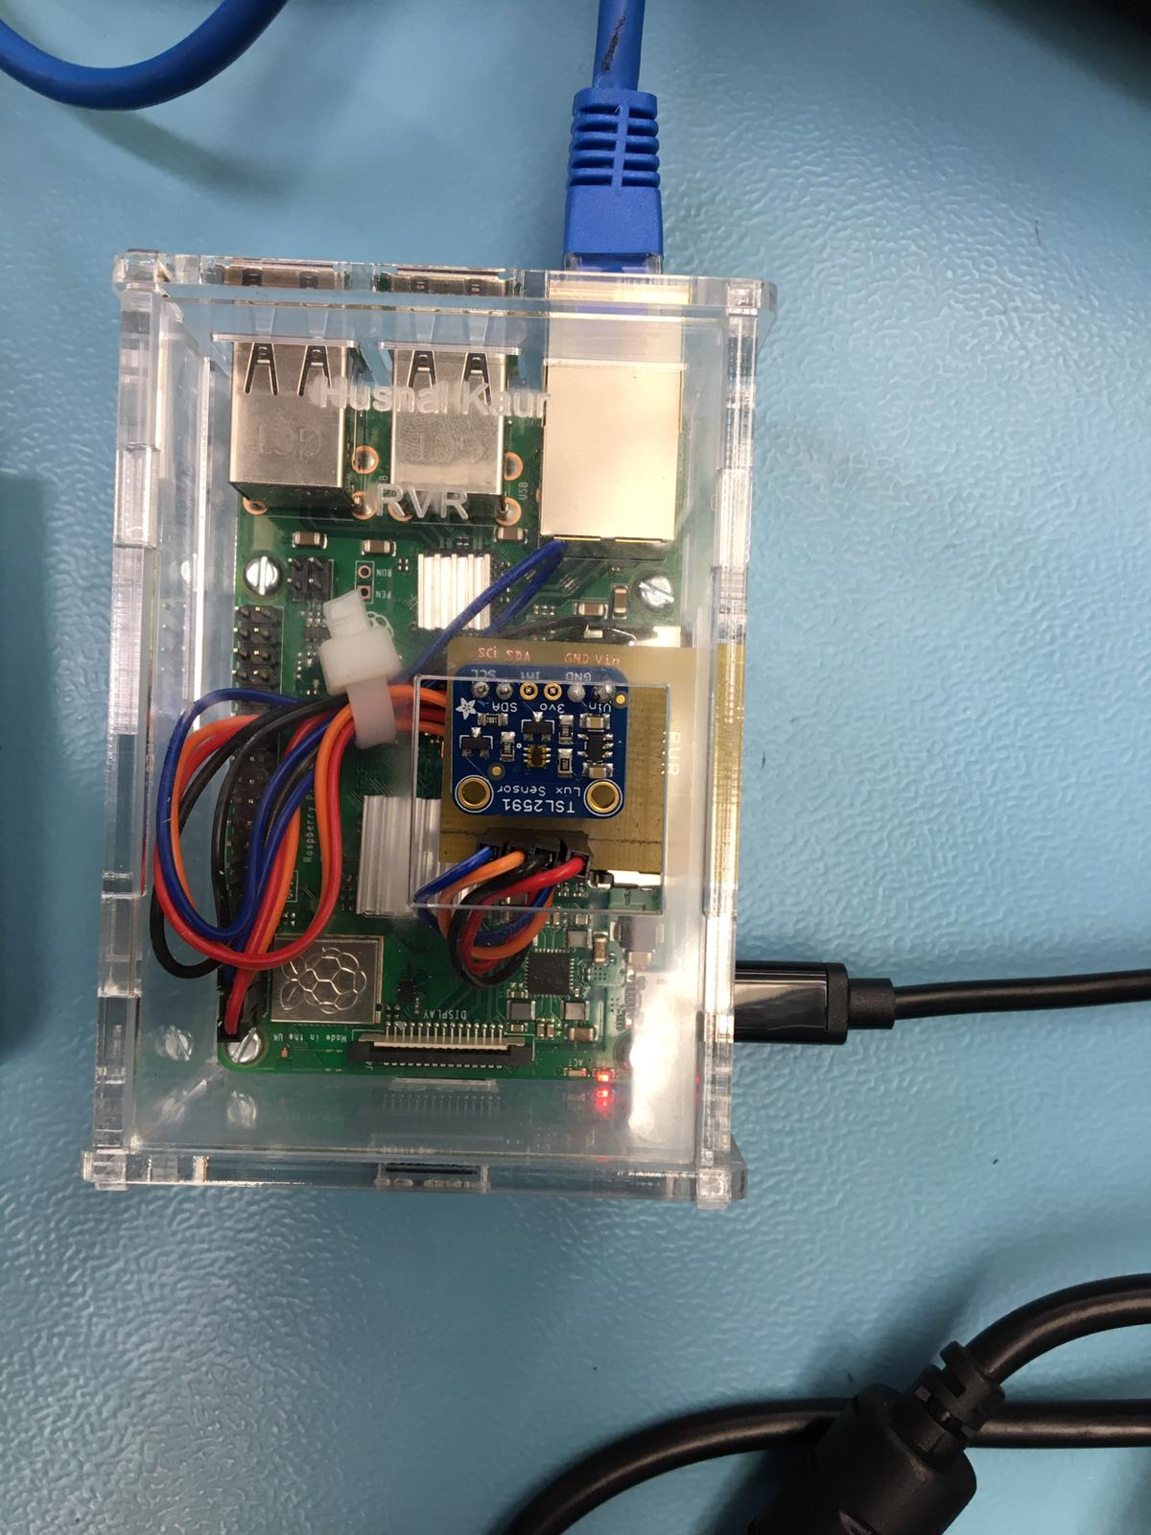
Finished Project

Slide 6
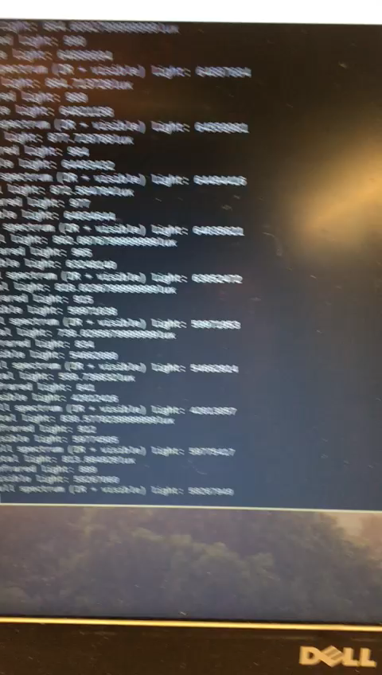
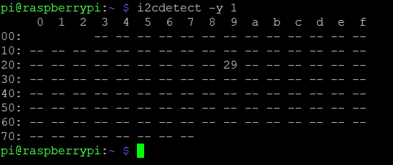
Output i2c bus

Slide 7
Previous course knowledge used
Technical C
Unix Scripting
Electric Circuits
Technical English
Embedded Systems
Software Engineering
Electronic Devices and Circuits

Slide 8
Thank you
-Husnal Kaur

